Slide 1

GROUP PRESENTATION (DUTCH LADY)
CT126-3-2-CTF-PRACTICAL
IERAE CTF 2025
CT126-3-2-CTF-PRACTICAL
CT126-3-2-CTF-PRACTICAL
IERAE CTF 2025

Slide 2
GROUP MEMBERS & CONTRIBUTIONS
Name | TP Number | Contribution
HEMANTHRAJAH A/L N KRISHNARAJAH | TP070844 | Tools, Commands, Scripts
ANUSHA DEVY A/P BRAHMATARAN | TP071154 | Write-up Content
DARMIK ISHWAR A/L RAVI | TP070071 | Conclusion
ADAM JEROME JOSEPH | TP071194 | Vulnerabilities & Skills Gained
SAILESS RAJ A/L RAJENDRAN | TP070996 | Challenges & Lessons Learned

Slide 3

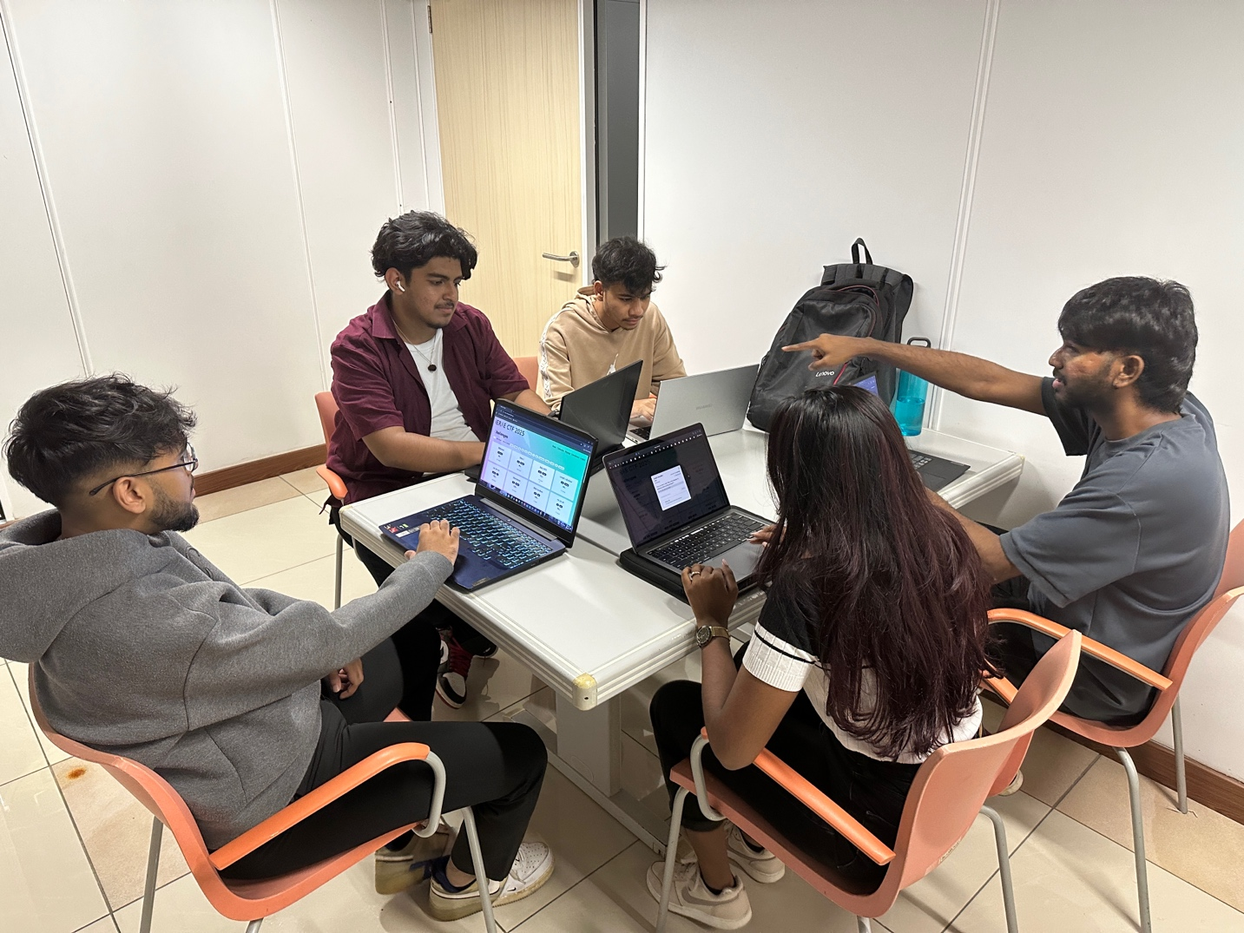
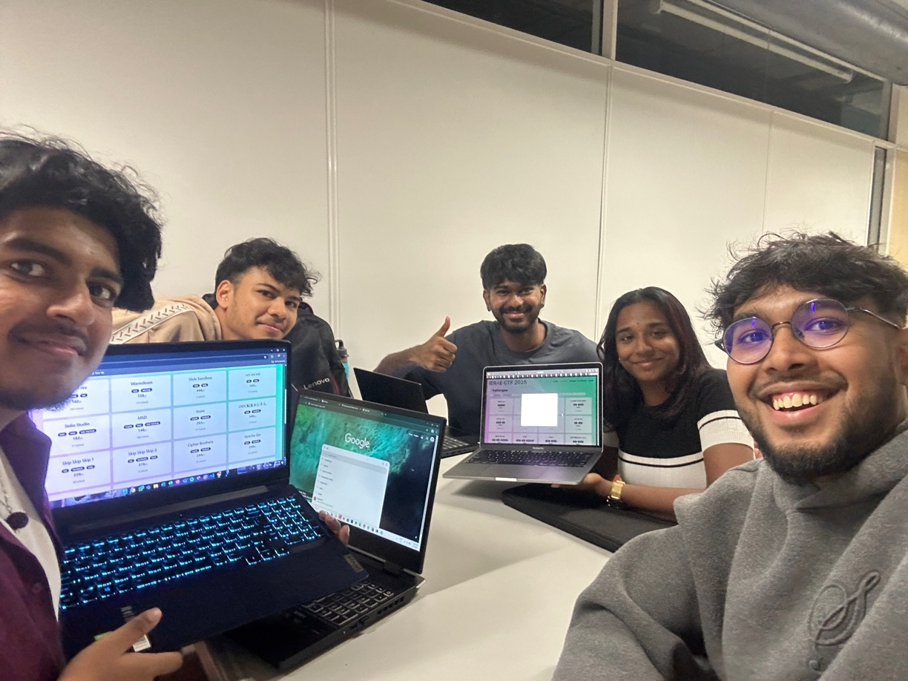
GROUP PHOTO
GROUP DUTCH LADY DOING THE CTF CHALLENGES

Slide 4
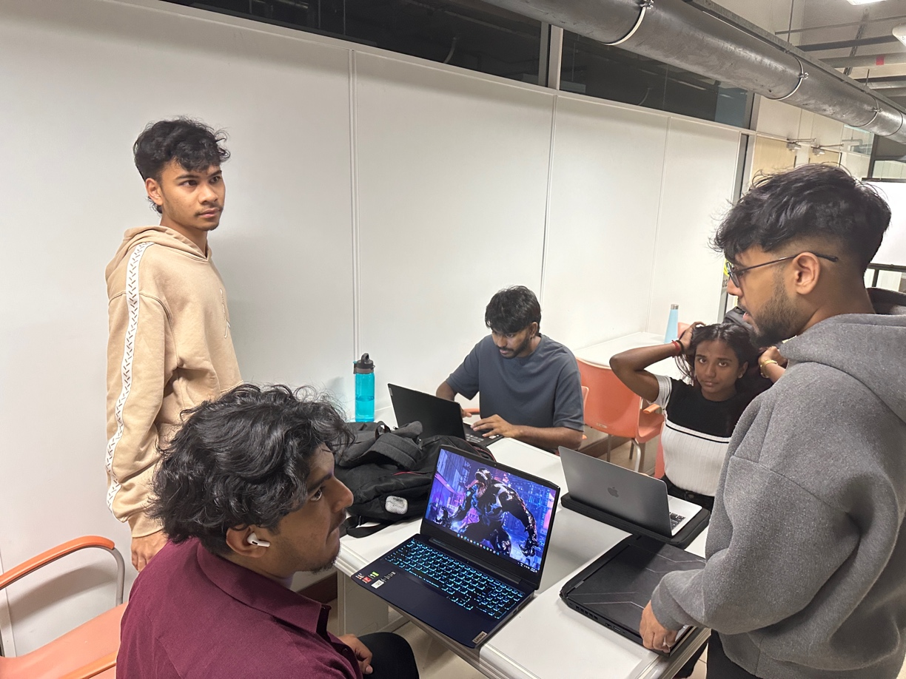
GROUP PHOTO
GROUP DUTCH LADY DOING THE CTF CHALLENGES

Slide 5
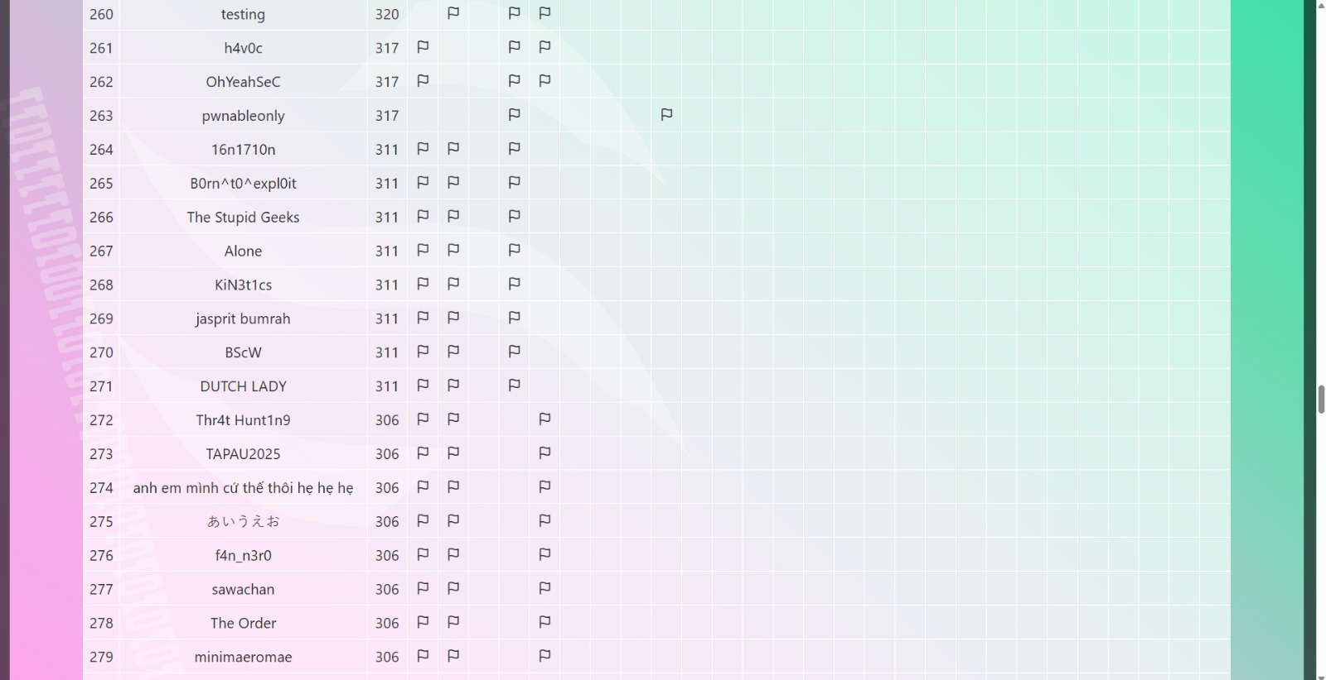
GROUP PHOTO
GROUP DUTCH LADY IN THE IERAE CTF COMPETITON

Slide 6
Introduction to the Challenge
Rev Rev Rev (102 points, Medium Difficulty)
Category: Reverse Engineering
Objective: Reverse Python obfuscation to recover the flag from output.txt
Files provided: chal.py, output.txt

Slide 7
CHALLENGE CATEGORY & WHY WE CHOSE IT
Category: Reverse Engineering
Beginner-friendly logical challenge
Python-based (team’s strength)
Teaches core concepts
Bitwise operations
Data transformation
Algorithm reversal
Skills developed:
Code analysis
Cryptographic thinking
Problem decomposition

Slide 8
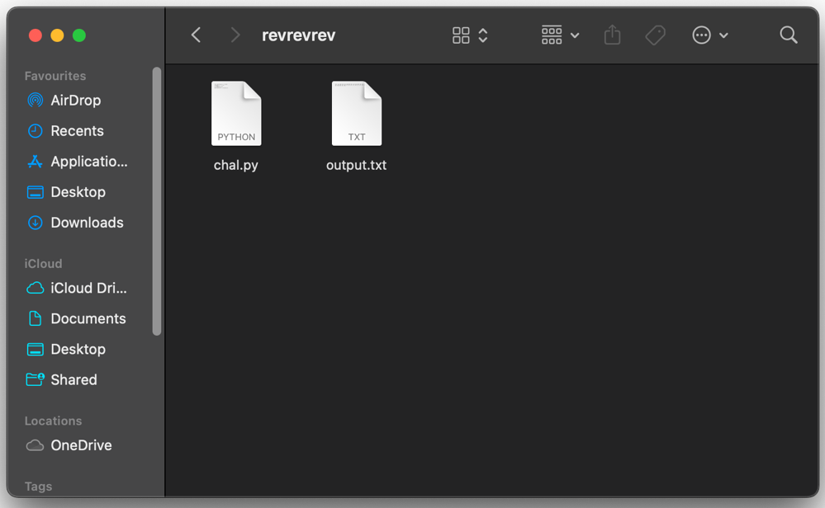
INITIAL SETUP
The transformation process: Original flag → ASCII → Reverse → XOR → NOT → output.txt
Key problem: "We had output but no original flag.txt"

Slide 9
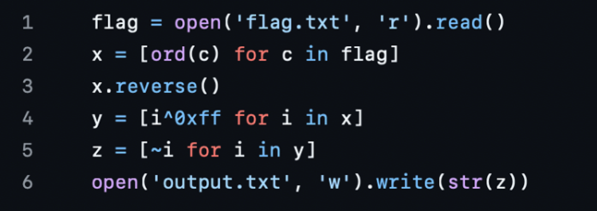
SHOWS THE CONTENT OF “CHAL.PY”

Slide 10
BRIEF EXPLANATION FOR CHAL.PY
flag = open('flag.txt', 'r').read()
- Reads original flag string from flag.txt into memory.
x = [ord(c) for c in flag]
- Converts each character in the flag to ASCII code, producing a list of integers.
x.reverse()
- Reverses the byte sequence to mirror the challenge’s .reverse() step.
y = [i ^ 0xff for i in x]
- Applies bitwise XOR with 0xFF to each byte, replicating the original XOR obfuscation.
z = [~i for i in y]
- Applies bitwise NOT (~) to each result, completing multi-stage hiding process.
open('output.txt', 'w').write(str(z))
- Writes resulting list of negative/large integers to output.txt, ready for CTF challenge input.

Slide 11
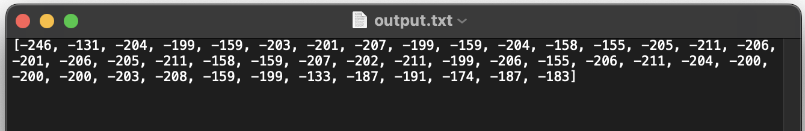
TRANSFORMATION DEEP DIVE
Visual explanation of operations:
ASCII conversion (ord())
List reversal (x.reverse())
XOR with 0xFF (bit flipping)
Bitwise NOT (negative numbers)
Example:
'A' → 65 → reversed → 65 XOR 255 → ~190 → -191
Reviewed output.txt
Identified multi-stage transformation pipeline

Slide 12
REVERSAL STRATEGY
Reverse engineering approach:
1. Read integers from output.txt
2. Apply bitwise NOT again
3. XOR with 0xFF
4. Reverse list
5. Convert ASCII to text (chr())
Visual flow:
output.txt → NOT → XOR → Reverse → ASCII → Flag

Slide 13
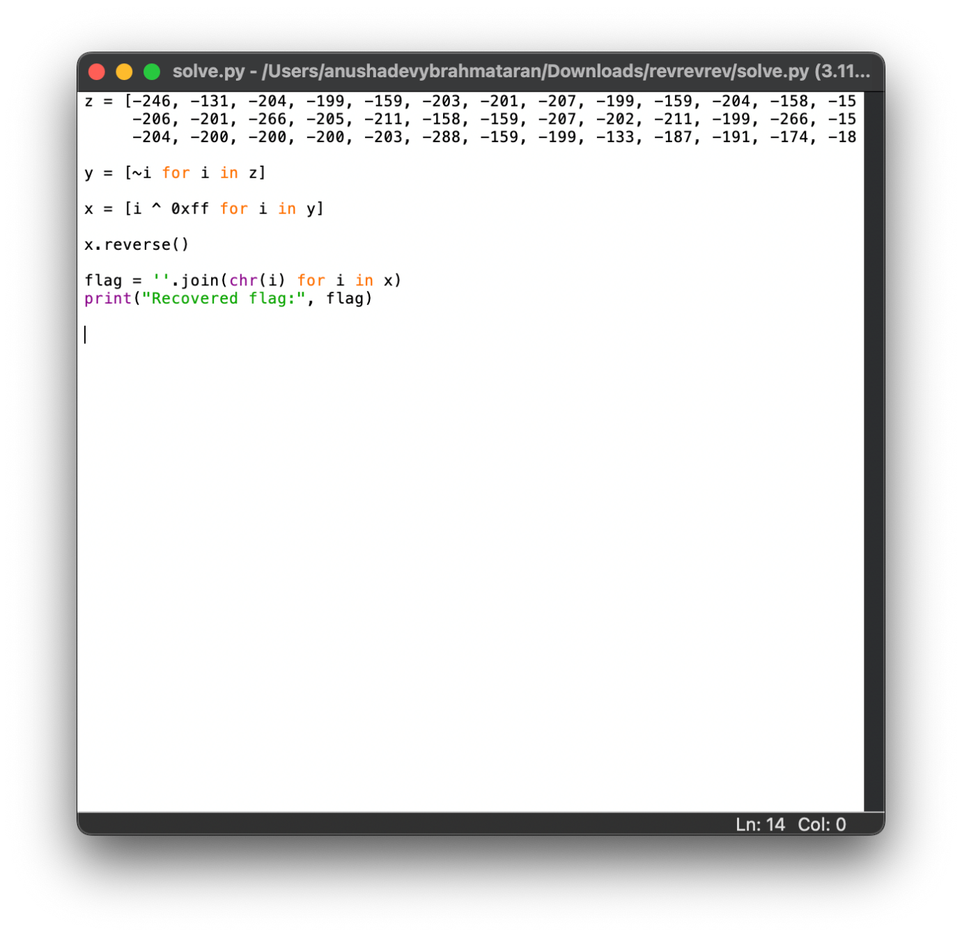
SOLUTION SCRIPT (SOLVE.PY)
Reverse Transformation:
y = [~i for i in z] # Undo NOT
x = [i ^ 0xff for i in y] # Undo XOR
x.reverse() # Undo reversal
flag = ''.join(chr(i) for i in x)
print("Recovered flag:", flag)

Slide 14
BRIEF EXPLANATION FOR SOLVE.PY
y = [~i for i in z]
- Applies bitwise NOT (~) to every integer in z, undoing the original ~ in the challenge script.
x = [i ^ 0xFF for i in y]
- XORs each byte with 0xFF, reversing the XOR obfuscation that was applied earlier.
x.reverse()
- Reverses the list so that the byte‐order matches the original sequence before .reverse() was called in the challenge.
flag = ''.join(chr(i) for i in x)
- Converts each numeric byte back into its ASCII character and concatenates them into one string.
print("Recovered flag:", flag)
Outputs the final, human‐readable flag to the console.

Slide 15
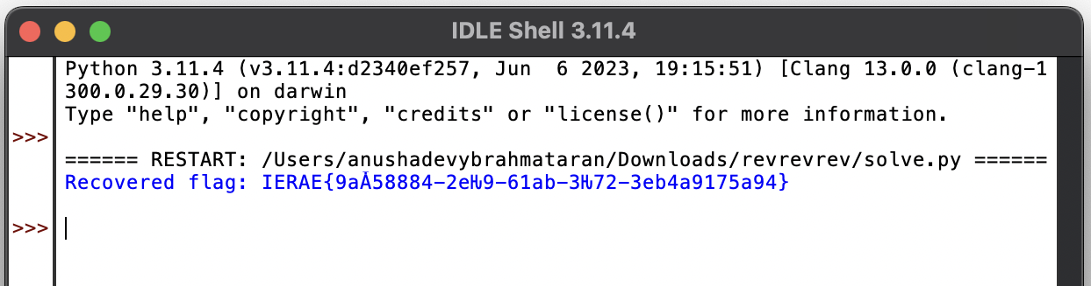
EXPECTED OUTPUT
Recovered flag: IERAE{9a058884-2e29-61ab-3272-3eb4a9175a94}

Slide 16
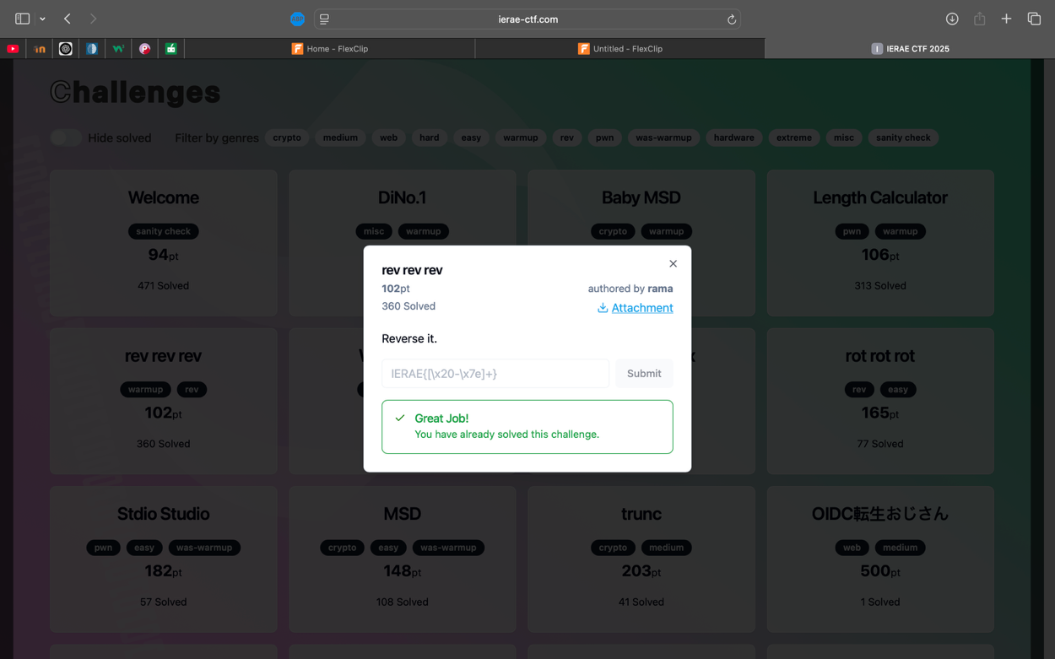
COMPLETION OF THE CHALLENGE
Flag has been successfully found!

Slide 17
SKILLS EVALUATION & COLLABORATION
Member | Skills Gained | Collaboration
HEMANTHRAJAH | Tooling & Scripting | Shared scripts and assisted team
ANUSHA | Technical Writing | Documented process clearly
DARMIK | Analytical Conclusion | Synthesized findings for report
ADAM | Reverse Engineering | Led code analysis steps
SAILESS | Problem-Solving | Managed challenge navigation

Slide 18

OUR FIRST LOOK AT THE PUZZLE
We opened a Python file full of strange negative numbers and felt like we were staring at a secret codebook.
It was like finding a puzzle with missing picture pieces. Exciting, but a little scary!
We huddled around our screens and said, “Okay team, how do we even start?”

Slide 19

SOLVING IT ONE LITTLE STEP AT A TIME
Divide & Conquer:
We each picked one part of the reversal pipeline (NOT, XOR, reverse, chr) like taking turns with LEGO bricks.
Test in Mini-Batches:
Before running the whole script, we tried a handful of numbers to see if our logic made sense.
Share & Check:
When someone got a small win, we high-fived and merged it back into the main code.

Slide 20
STUMBLING BLOCKS & HOW WE JUMPED OVER THEM
Bitwise Confusion: At first, ~i and i ^ 0xFF felt like magic spells. We drew diagrams on paper to visualize how bits flipped back.
Order Matters: We accidentally reversed before XOR one time—and the letters didn’t match. So, we added comments in our code to fix the sequence.
Time Pressure: With the clock ticking, we split tasks—two people debugged code, one wrote notes, one prepared the demo script—and that kept us calm under fire.

Slide 21
What We Learned & Why It Was Fun
Even a scary-looking puzzle can be tamed by breaking it into tiny steps.
Teaching each other (and explaining things in simple terms) made everyone stronger.
We won’t forget the thrill of seeing the final flag appear just like finding the hidden treasure at the end of a map!

Slide 22



Slide 23


